Slide 1
DATA RIDERS PROPERTY-PRICE : Decision tree and random forest
Presented by:
Smitha Jha
Santhosh Kumar
Yuvaraj Nachimuthu
Ekta Chaurasia
Avishek Deb
Srinath Ganesh

Slide 3
Residual analysis- Decision Tree
MAPE (Mean Absolute Percentage Error) | 16.955
RMSE | 37534
Number of Variables | 5 | 5

Slide 4
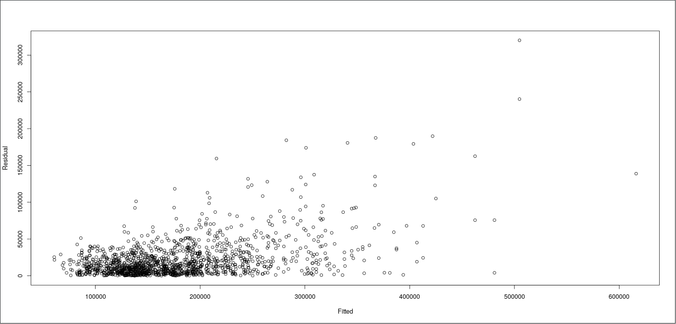
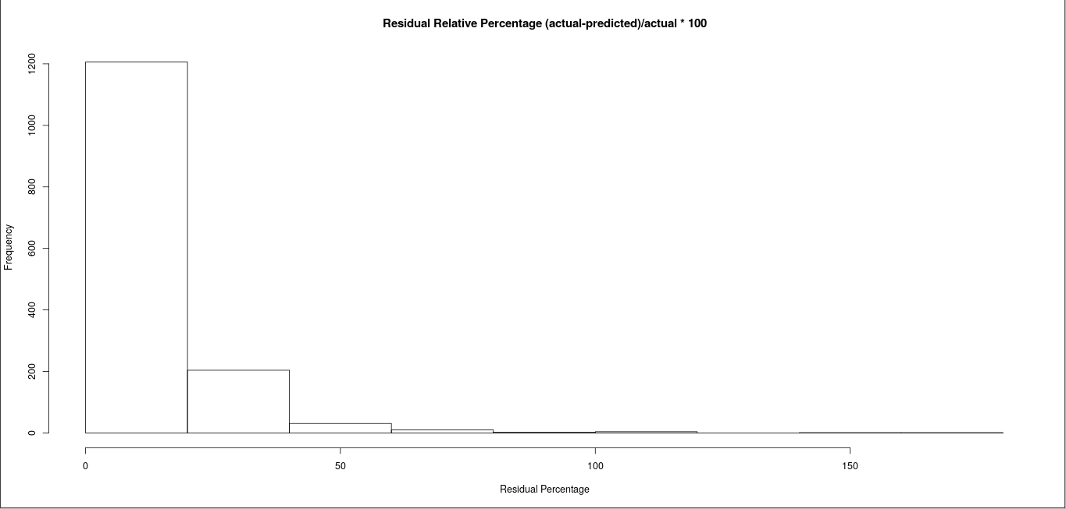
KNN
MAPE (Mean Absolute Percentage Error) | 12.16
RMSE | 33710
Number of Variables | 19 | 19
MAE (Mean Absolute Error) | 21395

Slide 5
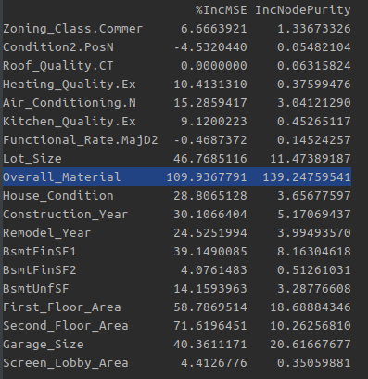
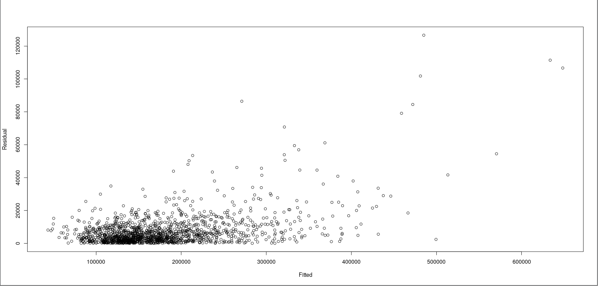
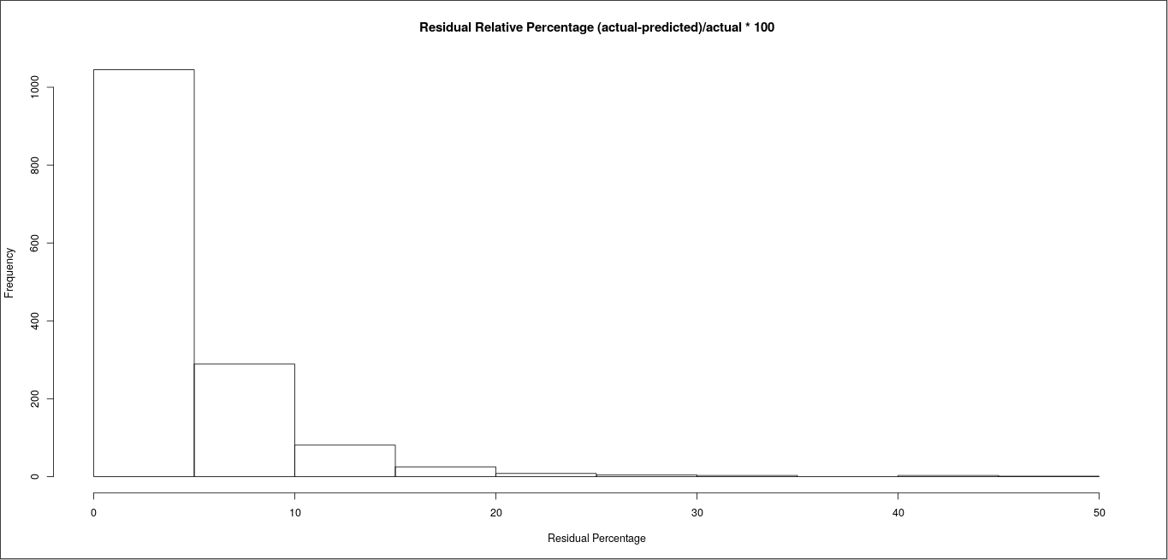
Random-forest
MAPE (Mean Absolute Percentage Error) | 4.22
RMSE | 12836
Number of Variables | 19 | 19
MAE (Mean Absolute Error) | 7590

Slide 6
Thank You
Github - https://github.com/srinathganesh1/Data-Riders/tree/master/LogisticRegression
Website - https://datariders.wixsite.com/datarider

